Slide 1
The National Guard:
The Affordable Solution for a Strong Defense

Slide 2

America’s Defense:
What the Founding Fathers Had In Mind
Build an Army When You Need It
“To raise and support Armies….to provide and maintain a Navy”
--The War Power and Military Establishment Clauses - Article I, Section 8, Clauses 12-
13, United States Constitution
Maintain a Strong National Guard When You Don’t
“To provide for calling forth the Militia to execute the Laws of the Union, suppress insurrections
and repel invasions”
--The Militia Clauses- Article I, Section 8, Clause 15,
United States Constitution
“The militia, long a staple of republican thought, loomed
large in the deliberations of the Framers, many of whom
were troubled by the prospect of a standing army in times
of peace. For the Founders, a militia, composed of a "people
numerous and armed," was the ultimate guardian of liberty.”
--Mackubin Owens, Professor of National Security
Affairs, United States Naval War College
Since 1636

Slide 3
A Dual-Mission Force
The National Guard has two distinct missions – one acting as a reserve component to the
active forces in time of war, and the other responding in the homeland to domestic
emergencies. When future planning decisions about our force are made, BOTH have to be
considered.
Title 10 Mission
The President of the United States can
call up the National Guard to participate
in federal missions.
The National Guard is a partner with the
Active Components and the Reserves
in fulfilling the country's military needs.
Guard units integrate into the Active
Components, bolstering crucial combat,
combat support, combat service
support, peacekeeping and
humanitarian relief missions
Title 32 Mission
Even in peace time, the Guard still has
an important job at home.
In each state, the Governor, through the
State Adjutant General, commands the
state Guard forces.
The Governor can call the National
Guard into action during local or statewide
emergencies – such as hurricanes, floods,
drought and civil disturbances – and can
activate them for counter-drug and airport
and border security missions.
A Job at Home and Abroad

Slide 4

Striking the Right Balance
What We’re Facing:
2 ground wars winding down in Middle East, with the
likelihood we’re not going to fight future wars like we have
in the past
Strategic shift to the Pacific, focused on Air Force and Naval
capabilities and less of a reliance on Army ground forces
A need to reexamine and rebalance foreign and national
security policy in ways that are more cost-effective
Reduced funding levels mandated through the Budget Control Act of 2011 and
sequestration, which hamper the military’s ability to modernize its force and maintain
the current structure to meet the challenges of a complex strategic environment.
Our current force design has not yet adapted to changing global and budgetary
circumstances.
Balancing Defense Needs With What America Can Afford

Slide 5

Budget Cutting
Using a scalpel instead of an ax
Budget decisions continue to be dominated by across-the-
board cuts to the armed forces, rather than by more cost-
effective strategies.
Instead of reducing the size of the military to meet budgetary necessities, the force
should be reshaped with the goal in mind of maintaining as much of the capability and
professionalism that exists in today’s forces as possible.
A large standing military is unsustainable
                In its current form, the U.S. military has become unaffordable.
Total personnel costs are consuming more
than half of the Defense Department
budget.
The spiraling personnel costs “will turn the Department of Defense into a benefits company that occasionally kills a terrorist.”
--Reserve Force Policy Board Chairman
MG Arnold Punaro (Ret.).

Slide 6
What Does the Guard Cost –
Not Mobilized
According to…..
Reserve Forces Policy Board
RC members cost between 22% and 32% of
AC service members over their lifecycle
Department of Defense Director of Cost
Assessment and Program Evaluation
(CAPE)
An RC brigade costs about 24% of the AC
brigade when not mobilized.
Army/RAND
One RC unit costs, on average, just 28.7% of
an AC unit when not mobilized**
**This is an important data point to note. This
finding that the Army’s average reserve
component unit costs 28.7% of its active
component counterpart is consistent with
the findings published in a report by the
Reserve Forces Policy Board. The Army agrees!
WHY THIS IS IMPORANT: This is the cost analysis basis on which forces should be built because this is the cost to maintain them over the long-term.

Slide 7
What Does the Guard Cost –
When Mobilized
According to RAND:
  2.3 Reserve Component units cost 108% as much as 1 Active Component unit
  This means that once a reserve component unit is mobilized for full-time duty, the cost
  increases to 47% of the cost of an AC unit
  On a per-unit basis, this is still a dramatically lower cost than maintaining a unit on full-
  time duty in the active component. This is a tremendous value.
Considerations:
  Though the costing models addressed are important, the analysis is flawed in several
  major ways which degrade its usefulness as a basis for making long-term force
  planning decisions.
  Because deploying to war is, for the immediately foreseeable future, a relatively rare
  occurrence, it is not a sound basis for long-term force planning decisions in “steady
  state” base budgeting.

Slide 8
Why the Guard Costs Less
The cost savings attributed to the community-based, part-time nature of the National Guard include:
Fewer pay days per year
Lower medical costs
Lower retirement expenditures
Significantly lower training costs
Virtually no cost to move to new duty stations every 2-3 yrs
Fewer entitlements, including housing and food allowances
Lower base support costs and services such as runways, base housing,
commissaries and child care facilities.
Additionally, National Guardsmen serve longer and retire later than their active duty component counterparts, maintaining expertise and increasing the value of their training.

Slide 9
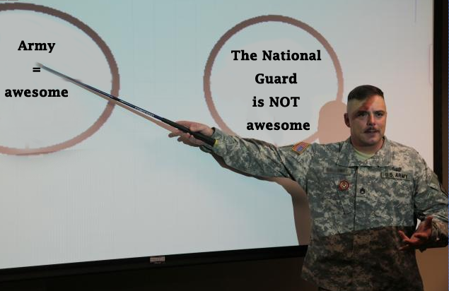
National Guard Myths vs. Facts
MYTH: RC members are more expensive than AC members
FACT: Not according to reliable costing models from the Reserve Forces Policy Board or OSD CAPE. Or by
using basic logic when you compare paying a part-time “as needed” force to a full-time force that you
have to pay all of the time (plus housing, commissaries, child care, hospitals, etc…etc….).
MYTH: It takes 2 years to mobilize an RC unit
FACT: The RC has demonstrated the ability to mobilize in <1yr, some units are available in 72hrs. And only a
few active units are ready at any given time. They’re not all going to go at once.
MYTH: Employers/Families/Soldiers are tired of deployments
FACT: The “Status of Forces” survey counters this statement, and employers indicate they will continue to
support their military members. Predictability is all they ask.
MYTH: The RC is inaccessible
FACT: The RC has proven to be accessible and hasn’t turned
down a single request.
MYTH: RC members are “Weekend Warriors”
FACT: Since 9/11, the ARNG as an Operational Reserve
has contributed significantly towards contingency
operations with over 750,000 mobilizations.
Trust Us, We’ve Heard It All

Slide 10

Training Days
According to the Army, they are available 24 hours a day, 7 days a week, 365 days a year. Let’s to the math!
Active Army
52 weeks per year =104 weekend days
10 Federal Holidays = 10
10 Training Holidays = 10
30 days leave = 30
Total days off: 265-154 = 211 days available for training.
However, the Army manages their training cycle in 3 phases: red, amber, green. The reality is the Army typically trains ~180-220 days per year.
ARNG
Required = minimum of 39 days /year (15 days AT + weekend drill 1/month)
The average Army National Guard soldier serves far more than that:
~17% of ARNG– nearly 60,000 soldiers – serve full-time as either military technicians or AGR
~40,000 ARNG soldiers will average about 4 months each year in full-time basic or advance individual training.
The FY2014 budget request, for example, seeks funding to support an average of 94.2 duty days per Army National Guard soldier.
Must train!
ARNG provides 43% of the duty days at about 28.7% of the cost.

Slide 11
Growing and Downsizing
End Strength in 2000:
Army – 482,700
ARNG – 350,000
“Grow the Army” / War Surge*:
Army – 570,000
ARNG – 358,200
* In order to better respond to changing dynamics in the wars in Iraq and Afghanistan, the Army was authorized to temporarily grow to meet those obligations.
Since both ground wars are winding down quickly and the need to maintain a large standing Army would be excessive, the Army is shrinking back down to pre-9/11 levels.
1st Planned Reduction:
Active Army down to 490,000 (even above pre-9/11 levels)
ARNG down to 350,000 (right at pre-9/11 level)
These reductions are NOT CUTS (proportional or otherwise), as the Army alleges, but a return to a peacetime-sized force after the necessary growth for 2 wars.

Slide 12
BCT and End Strength Comparison: Active Army vs. Guard
9/11
PDM III
GTA
TESI
Here’s where it started getting expensive…
PDM III: Program Decision Memorandum III (QDR 2006)
GTA: Grow the Army
TESI: Temporary End Strength Initiative

Slide 13
Actual Proposed Cuts under Sequestration
Army’s End Strength Plan
Active Army – 420,000
ARNG – 315,000
What’s Wrong with the Army’s Plan?
According to General Odierno’s, his plan will:
Degrade readiness
Create extensive modernization program shortfalls
Add significant risk for the Army to conduct even one sustained major
combat operation
Limit training
Separate large numbers of high quality experienced, combat Veterans
A Bad Plan for the Nation

Slide 14
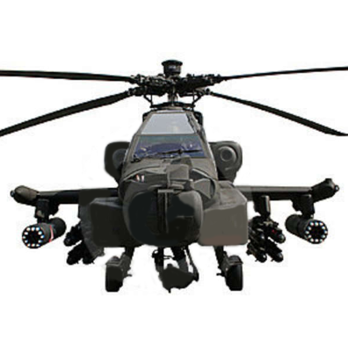
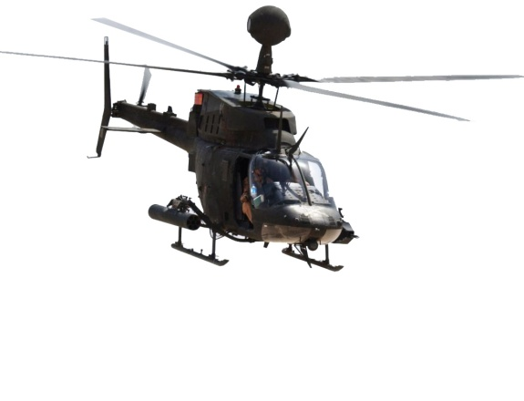
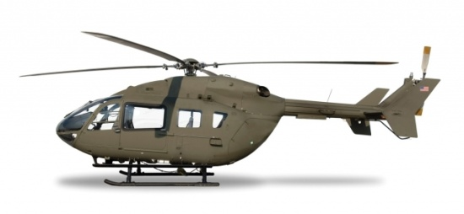

Army Aviation Plans Guts Guard
UH-72 Lakotas
AH-64 Apaches
OH-58D Kiowa
Warrior
C-12
Army Plan: Cut 1/2 the total fleet ~ 104 aircraft across all states
Army Plan: Cut ALL Apaches and Kiowas in the Guard fleet
Army Plan: Reduce inventory by 16
Loss: 326 aircraft
Proposed Replacement: 111 older UH-60L models
Total loss: 215 aircraft
What This Means:
Apaches will go to Active Duty Combat Aviation Brigades, and all other ARNG aircraft will go to
Active Duty training schools at Fort Rucker
Loss of attack and recon capabilities in the Guard with no bridging strategy to future aircraft
Same path as the ANG – inability to augment Army as a true reserve
Hinders SAR capabilities in DSCA/FLIR
ARNG Maintains Depth, Strength and Flexibility of Combat Aviation
for Less Cost in Existing Facilities

Slide 15



Think Tank Experts Agree-
National Guard is the Answer
“We must redesign our forces and budget to our strategy, and not to equal service share between branches…The active duty Army would be reduced by 200,000 soldiers from the 490,000 planned in the FY2013 budget, with an increase of 100,000 reservists and National Guardsmen closely entwined in the regular rotation whose principal mission would be arriving in a mature theater for sustained combat. Putting more of the responsibilities for ground combat into the combat-proven reserve component is both consistent with the new demands of the evolving international order and justified by the superb performance of National Guard and reserve units in our recent wars.”
--- Adm. Gary Roughead, U.S. Navy (Ret.) and Kori Schake, “National Defense in a Time of Change” The Hamilton Project (Brookings Institution), February,2013.
“In past eras of fiscal restraint, Pentagon officials reduced the U.S. military’s operational reliance on the Guard and Reserves and cut their budgets, in part due to the inherent tension between full-time active duty and reserve personnel. …..Now is an opportune time for the U.S. government to bridge the cultural, bureaucratic and budgetary gulf that still divides full-time active duty and reserve personnel. “
--- General Gordon R. Sullivan, USA (Ret), AUSA President, “An Indispensable Force: Investing in America’s National Guard and Reserves”, September, 2010.
“We should be moving more toward a smaller, more agile active-duty Army and save bigger missions for the Reserves.”
--- Larry Korb, Center for American Progress, “Reshaping the Army,” TIME Magazine, November 4, 2013

Slide 16
Proposals
NGB Proposal
Army Plan
335K
Force Structure
315K
Readiness reduced with
similar impact to AC
345K
End Strength
315K
Rebalanced capabilities
will require > 5 yrs to
regain readiness
Gross turbulence: 17,723 spaces
26
Brigade Combat Teams
22
Gross turbulence: 48,011 spaces
Unprogrammed cost: $265 million
8
Combat Aviation Brig.
6
Unprogrammed cost: $1.07 billion
End state is an avg. 3% FSA reduction
End state is an avg. 8.8% FSA
reduction
Attack Aviation
Battalions
6
0
Reduces risk to meet nation’s needs
Increases risk to nation’s needs
$1.7 Billion
$16.2B reduction
To $14.5B (BCA)
Reduces 4,000 AGRs (28,810 to 24,810)
Reduces 1,284 MILTECHs (27,210 to 25,926)
Total: 5,284 fulltime
Reduces 2,927 AGRs (28,810 to 25,883)
Reduces 2,814 MILTECHs (27,210 to 24,396)
Total: 5,741 fulltime

Slide 17
Offering Alternatives
On many occasions over the past few months, the National Guard has presented alternatives to the Army that would fulfill the original Army National Guard (ARNG) portion of shared reductions required in the Budget Control Act (BCA), but those recommendations have yielded no prospect of change to the Army’s original plans to significantly reduce the ARNG.
The ARNG proposal would sustain most of the current ARNG force structure, and would garner the needed savings from:
  Military construction
  Facilities maintenance
  Training
  Schools
  Recruiting
  And other areas
The ARNG proposal would assume a minimally acceptable readiness risk, but would sustain capacity to provide a trusted and responsive force to safeguard our communities and defend the nation.
The National Guard can move the nation off a
"permanent war footing" but retain affordable security

Slide 18
The Way Ahead
With divergent views on the best solution and so much at stake, there is ample time for
study and reflection. Congress has the opportunity now to slow the process and review
the nation’s security needs and the best way to meet those needs in an affordable
fashion.
Request the analysis for these decisions.
Support the House bill H.R. 3930 - “National Commission on the Structure of the Army Act of 2014”, which:
    Prohibits the Army from using FY15 funds to divest, retire, or transfer, or prepare to divest, retire, or transfer, any aircraft of the Army assigned to units of the Army National Guard as of January 15, 2014.
    Prohibits the Army from using FY15 funds to reduce personnel below the authorized end strength levels of 350,000 for the Army National Guard as of September 30, 2014.
    Establishes the National Commission on the Structure of the Army
Leverage the cost-effective National Guard
as the solution for preserving Total Force capability

